Slide 1
ECEN 403:
Active Ankle-
Foot Orthosis (AAFO)
Polina Golikova
Alfred Boss
Christopher Galik
Tyler Pierce

Slide 2
Project Overview
Medical complications result in restricted motion control of lower leg and lack of muscular support.
AAFOs attempt to supplement that motion and support it by providing another source of power.
P.A.C.T.s AAFO will improve upon previous designs by:
Integrating input from muscular signals and binary control system from mechanical sensors.
Incorporating novel technology developed through research.

Slide 3
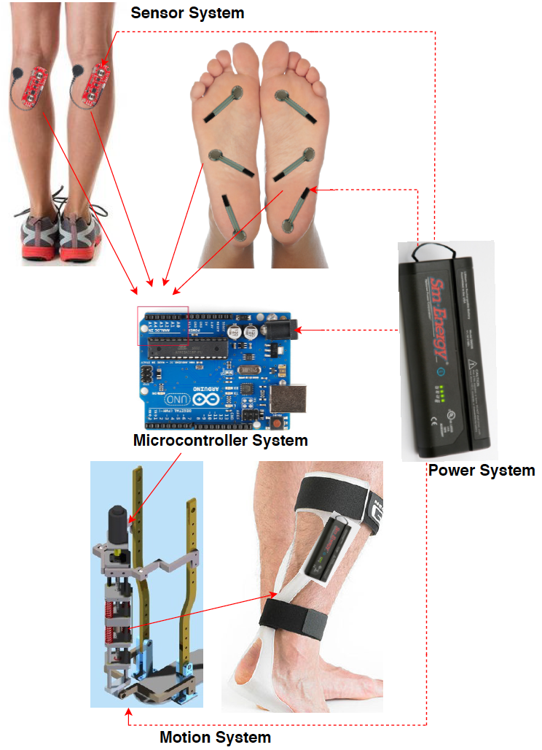
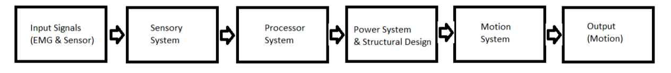
System Overview
Electrical EMG sensors and mechanical sensors will measure electrical activity and pressure in the leg and foot.
The AAFO will transport signals from the 2 sensors to the MCU.
The microcontroller will interpret signals and determine which stage of gait the user is in and supply corresponding motor control through the power system.
The motion system, which acts as an artificial muscle, will move the joint by attaching to a rigid structure.

Slide 4
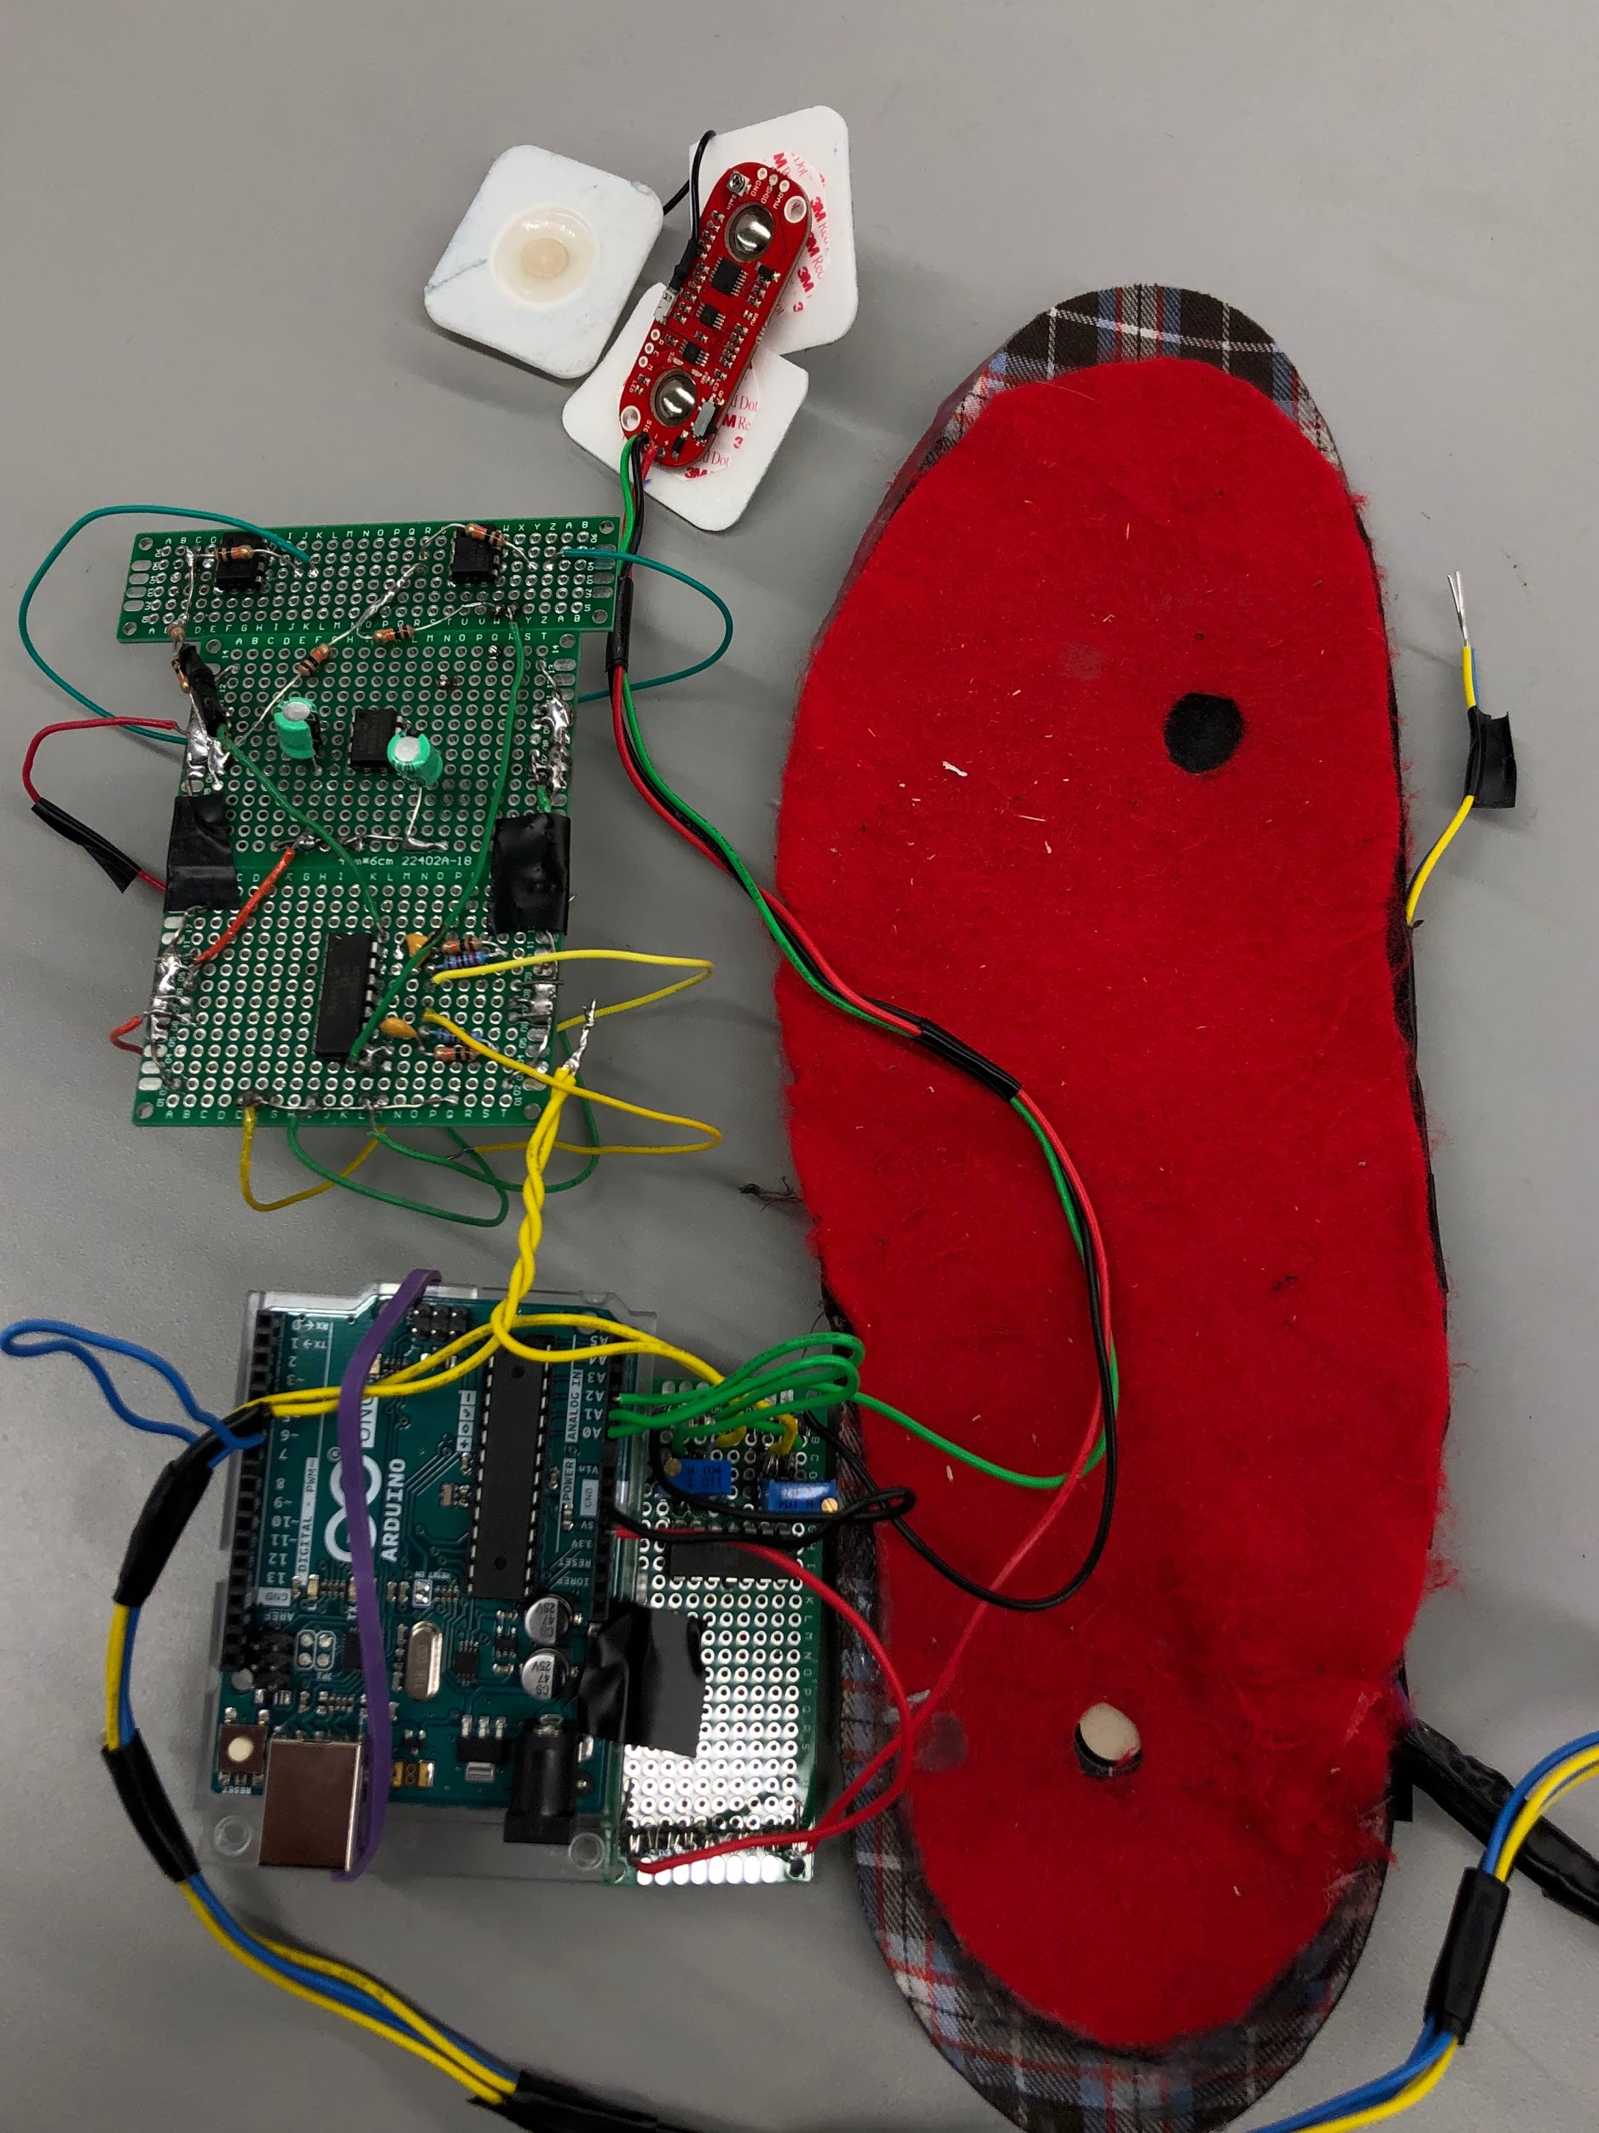
Sensor System - EMG & Pressure
Accomplishments (80 hours / 4 weeks)
Sensor System Prototype complete
Designed and implemented two possible solutions
Drafted, Breadboarded, Simulated, and Soldered, and tested pressure system circuits
Positioned EMG sensors at precise location on Soleus
Developed Arduino code for EMG & Pressure sensors
Ongoing progress
Solder Ball sensor and position (for prototype)
Implement system into final design
Potentially incorporate additional sensors (accelerometer; more pressure sensors)

Slide 5

Sensor System - Validation

Slide 6
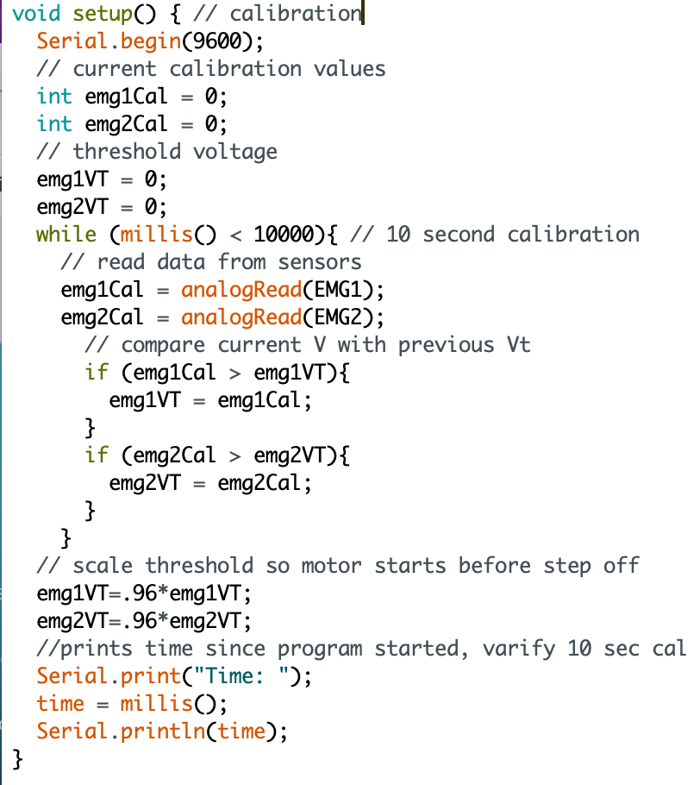
Microcontroller Overview
Completed Work:
Calibration period to analyze threshold Voltage for EMG sensors.
Compared incoming EMG data to threshold EMG, incoming FSR to previous FSR state value.
Matched correct conditions to enable a patient to take a step or stay idle
Future Work:
Incorporate multiple walking states for 100% power, partial power, and 0% power to the motor.
Adjust threshold scale factor depending on calibration values.

Slide 7
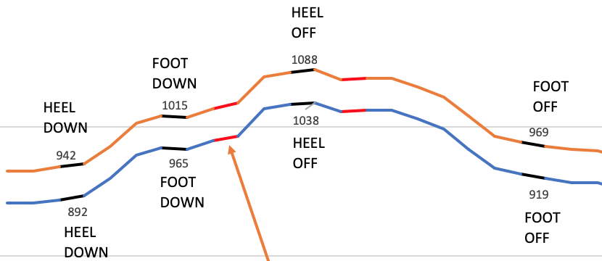
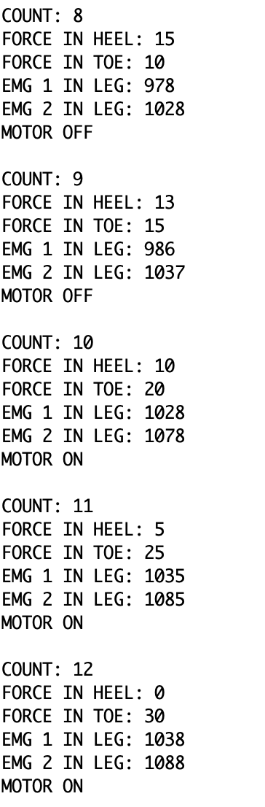
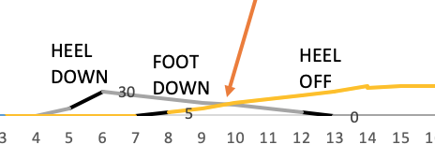
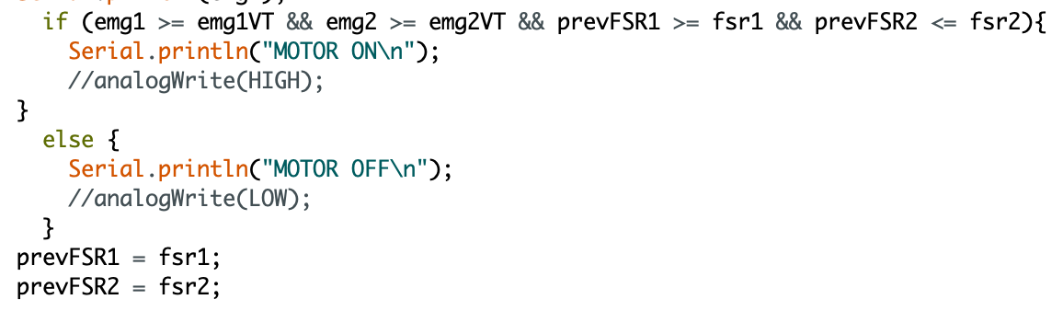
Microcontroller Validation
System Execution:
Use collected EMG and matching FSR data, find Time when motor is enabled, compare expected with program Time
System Validation:
Expected motor ON is at T=10
Program motor ON is at T=10
Motor on at T=10

Slide 8
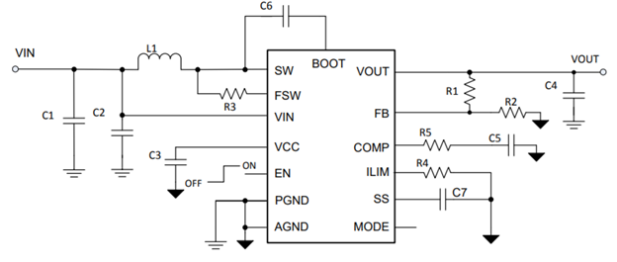
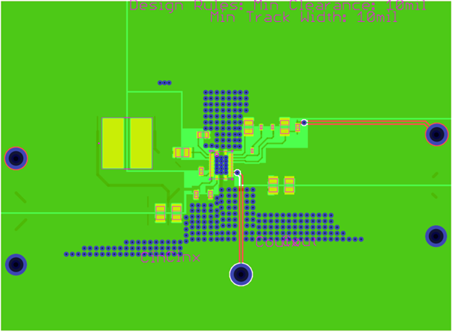
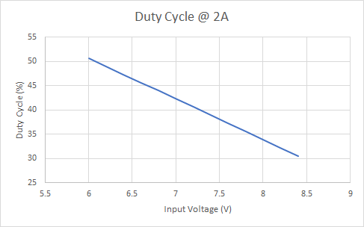
Power System
Completed Work
DC-DC Boost Converter schematic & PCB design completed
H-bridge schematic completed
Ongoing progress/problems and plans
Trouble validating H-bridge without Microcontroller
PCB shipment & Soldering
Future Work:
Interface with AM, Multiple walking states
Validation

Slide 9
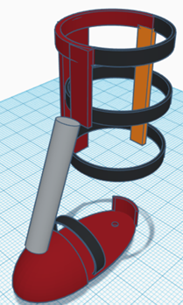
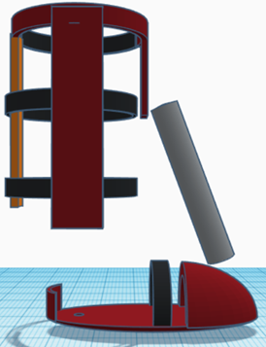
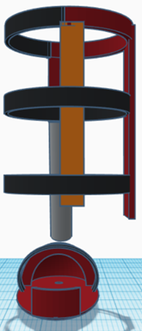
Structural Design
Completed Work
3D design based on 18” lower leg/calf length and foot size 10 ½” x 3 ½”
Future Work:
Finalize structure features with subsystems, Further detailed design with AutoCAD 3D, 3D printing & Materials

Slide 10
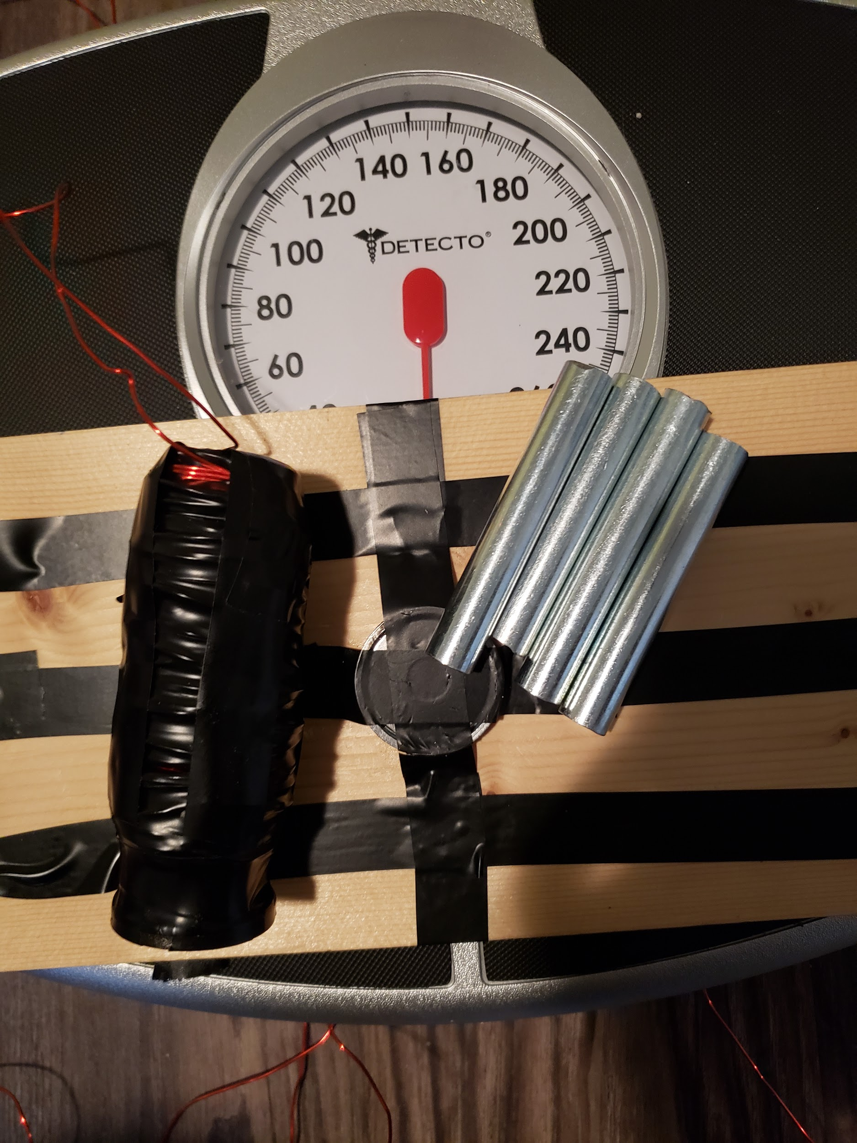
Artificial Muscle
Completed Work
Further optimization problems addressed
Control over output power
Preliminary strength tests completed (Force of 20 lbs at ¼ inch away)
Future Work
Incorporate with structure
Refine controls during incorporation with microprocessor

Slide 11
